Slide 1


Solar dehydrator
Team one
SOLAR DEHYDRATOR
GREENENGINEER THINKING
Frederike Brunke
Daniel Berenyi
Adrian de la Torre
Murat Gusan
Leonore Hood
Hubert Nogal

Slide 2
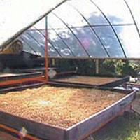
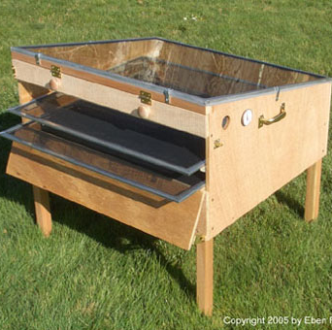
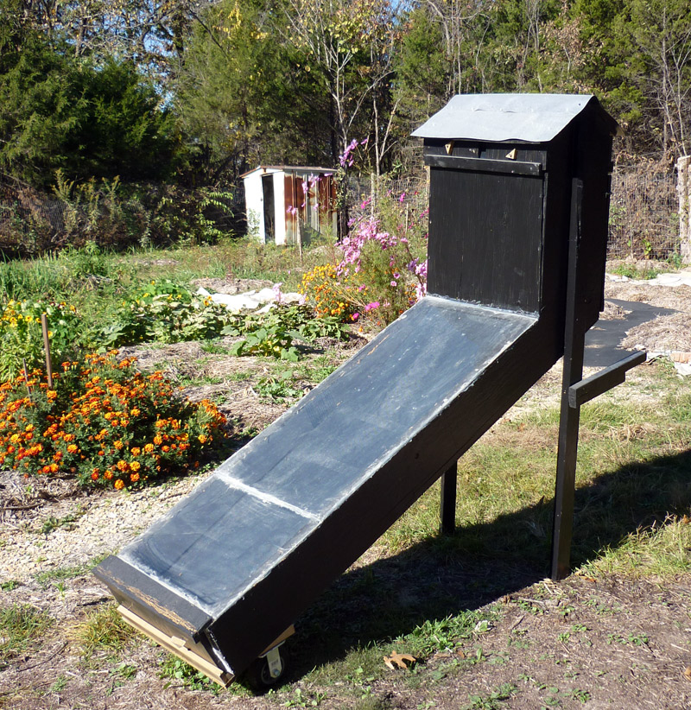
Solar dehydrator
Team one
WHAT’S A SOLAR DEHYDRATOR?
& STATE OF THE ART
CONCEPT
FOOD DEHYDRATION &
LONG-TERM CONSERVATION
+
ONLY USE OF SOLAR ENERGY
=
SUSTAINABLE CONTRIBUTION
STATE OF THE ART
CURRENT MARKET & COMPETITORS

Slide 3
Solar dehydrator
Team one
STATE OF THE ART
INNOVATION
PROJECT REQUIREMENTS
CONTROL OF TEMPERATURE
AND HUMIDITY PARAMETERS
USE OF BRAINSTORMING TECHNIQUE
PORTABLE
LIGHTWEIGHT
USER FRIENDLY
GOOD LOOKING DESIGN

Slide 4
Solar dehydrator
Team one
OUR COMPANY
& GOALS
PROJECT MANAGEMENT
· Time management:
milestones and deadlines
· People: task allocation
· Scope: project and product requirements
MARKETING
· Micro & macro analysis
· Market segmentation
· Target group

Slide 5
Solar dehydrator
Team one
OUR COMPANY
& GOALS
SUSTAINABILITY
· Recyclable materials
· Sustainable packaging and distribution
ETHICS AND DEONTOLOGY
· Engineering ethics
· Environmental ethics

Slide 6
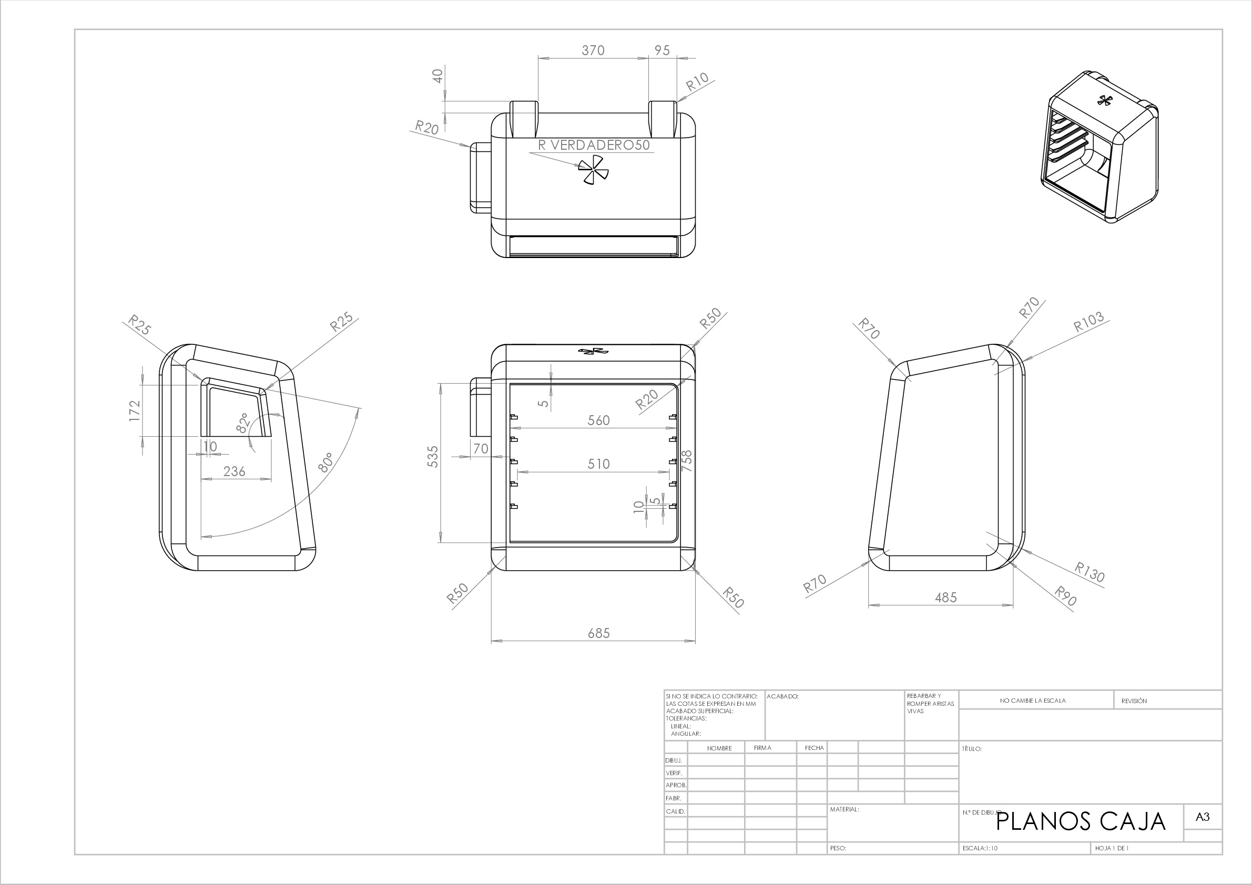
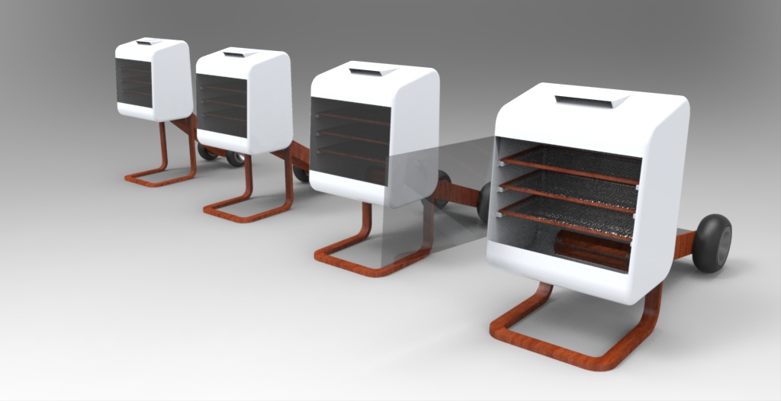
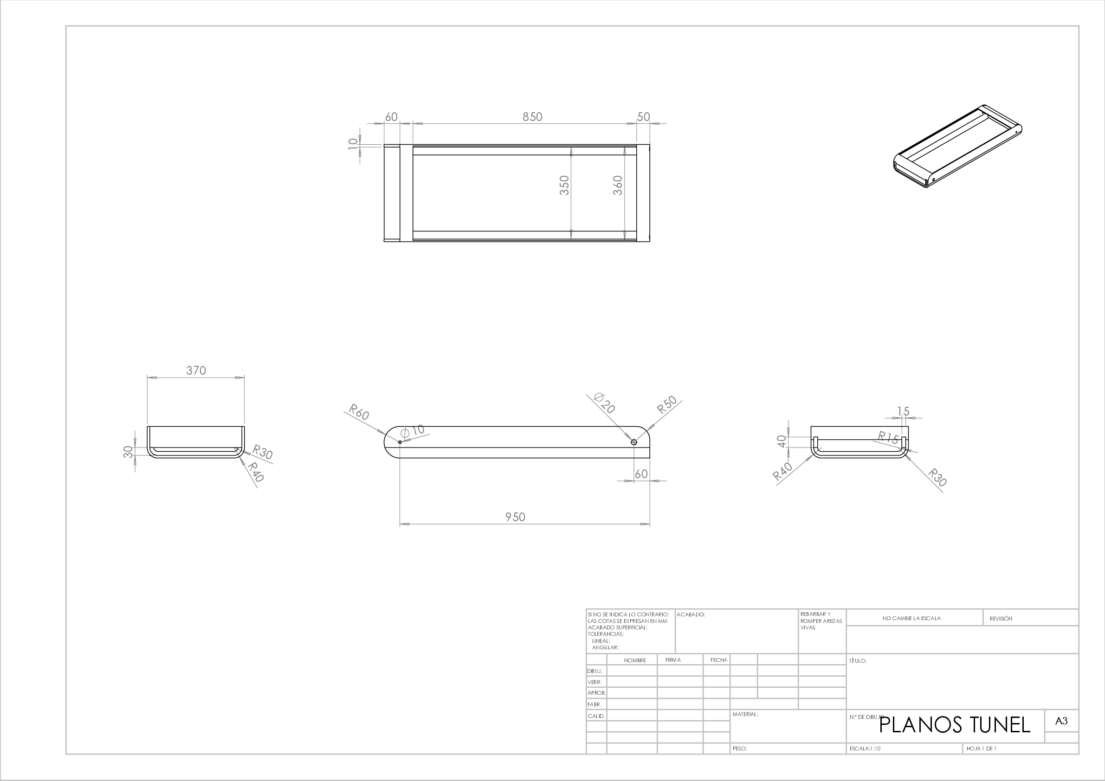
Solar dehydrator
Team one
PRODUCT DEVELOPEMENT

Slide 7
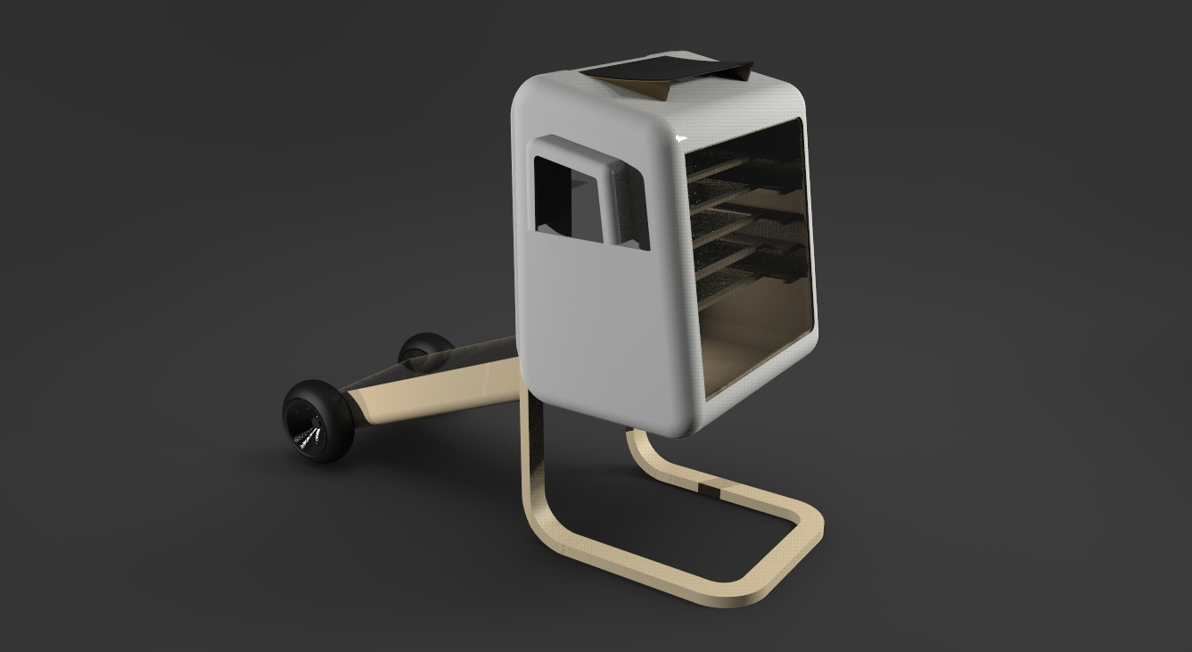
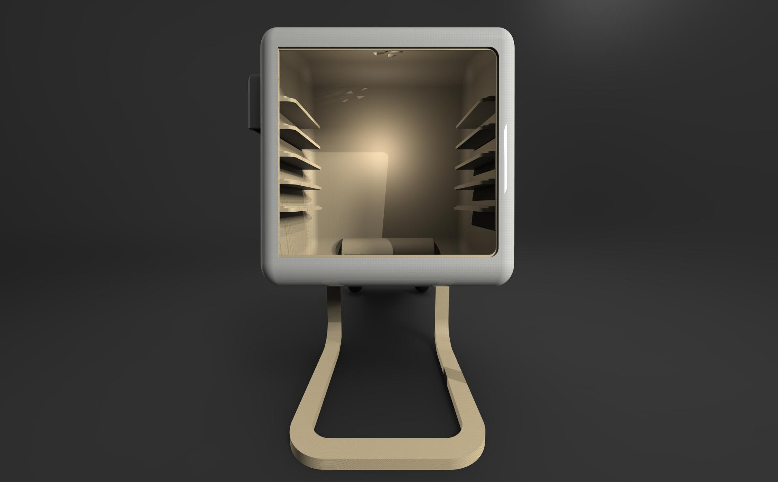
Solar dehydrator
Team one
PRODUCT DEVELOPEMENT
PORTABILITY

Slide 8
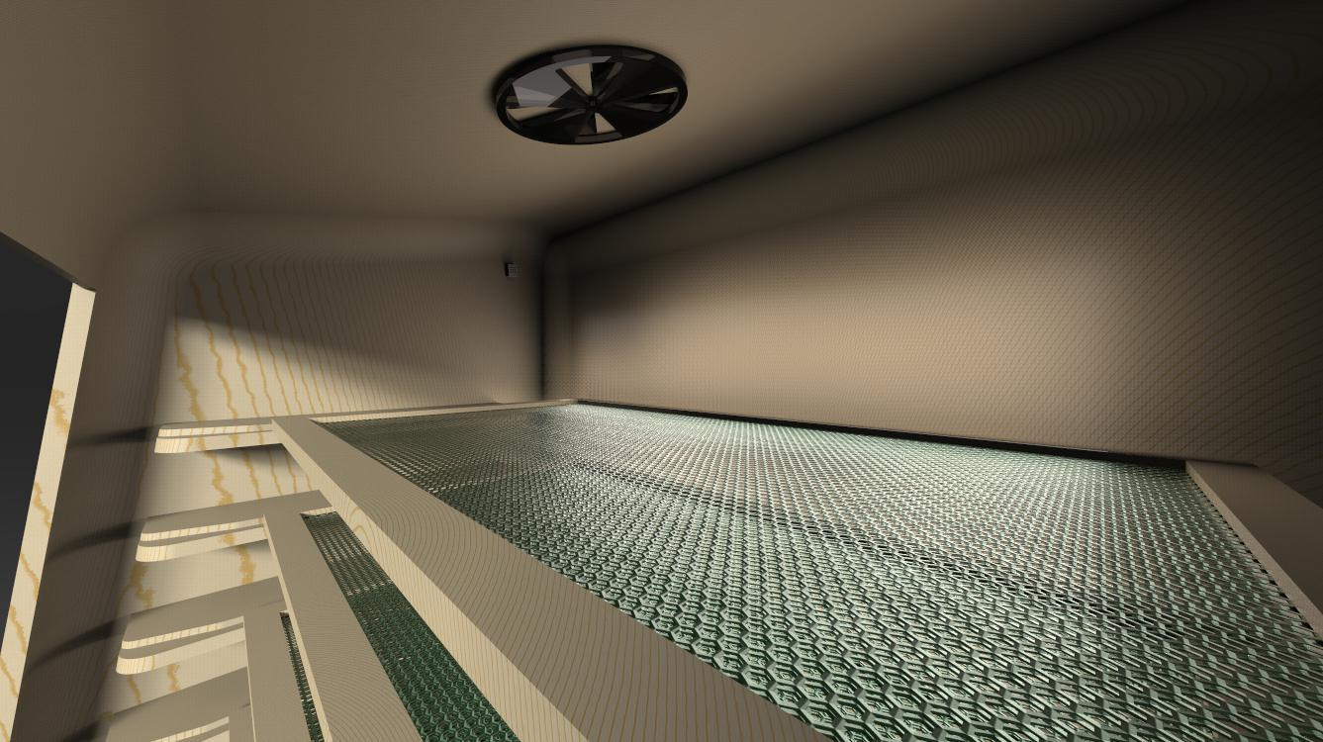
Solar dehydrator
Team one
PRODUCT DEVELOPEMENT
PORTABILITY

Slide 9
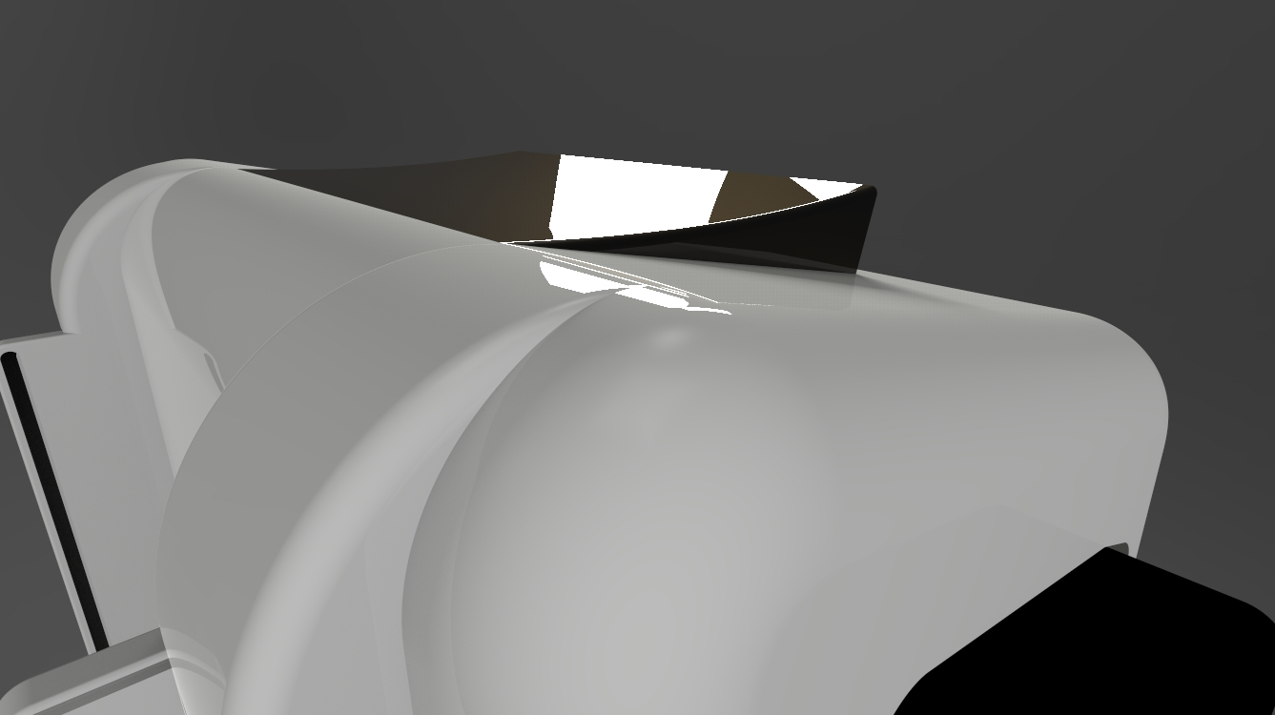
Solar dehydrator
Team one
PRODUCT DEVELOPEMENT
PORTABILITY

Slide 10
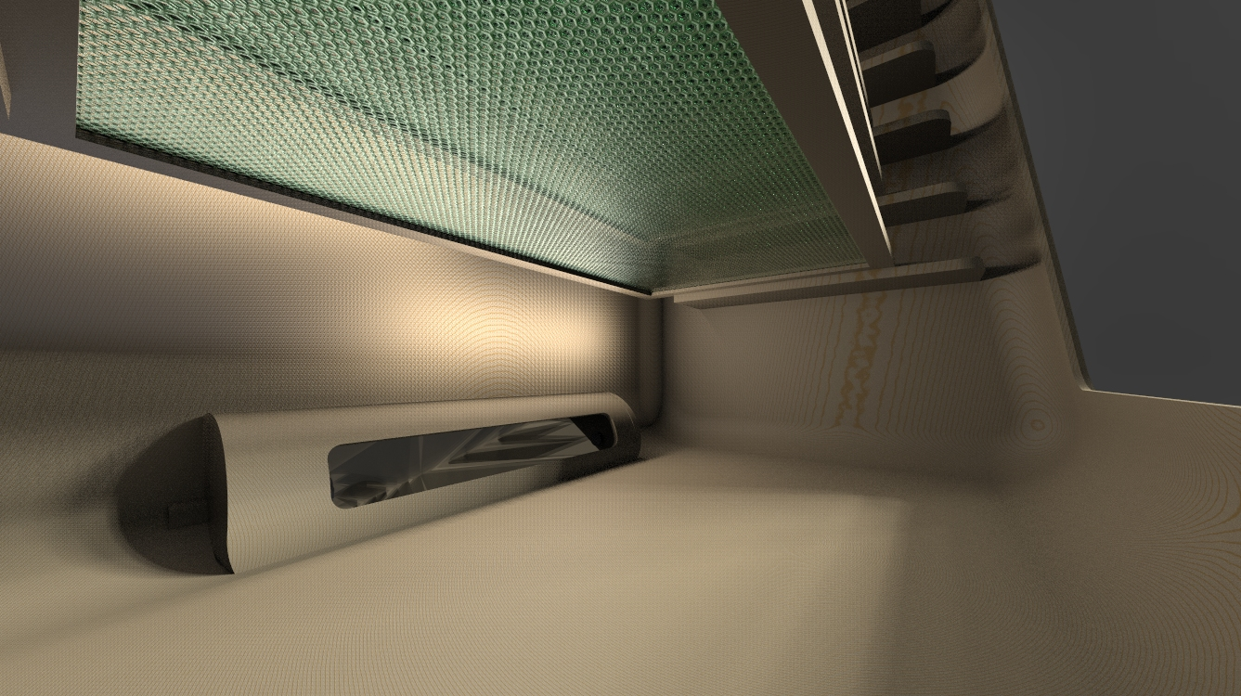
Solar dehydrator
Team one
PRODUCT DEVELOPEMENT
PORTABILITY

Slide 11
Solar dehydrator
Team one
PRODUCT DEVELOPEMENT
MATERIALS
HEATING TUNNEL
WOOD
GLASS
METAL SHEET
PLASTIC GRID
WHEELS
DRYER BOX
WOOD
PMMA
PLASTIC GRID
ELECTRONICS
ELECTRONICS
ARDUINO
TEMPERATURE & HUMIDITY SENSOR (DHT22)
SERVOMOTOR
LCD
BUZZER

Slide 12
Solar dehydrator
Team one
PRODUCT DEVELOPEMENT
PORTABILITY

Slide 13
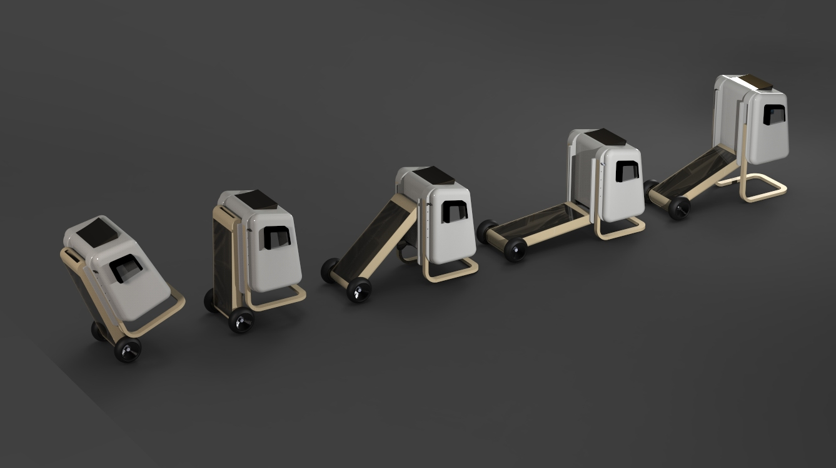
Solar dehydrator
Team one
PRODUCT DEVELOPEMENT

Slide 14
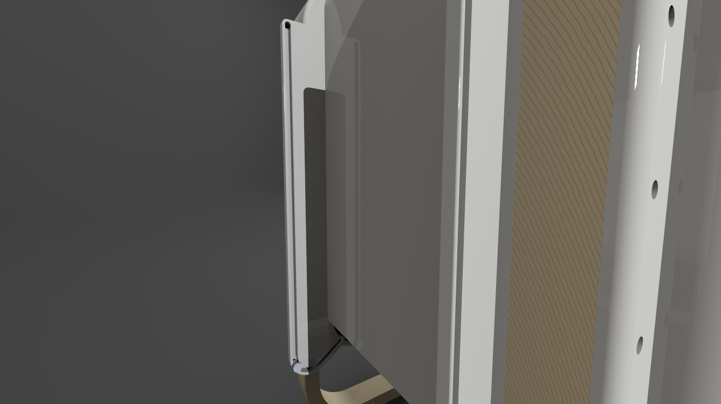
Solar dehydrator
Team one
PRODUCT DEVELOPEMENT
PORTABILITY

Slide 15
Solar dehydrator
Team one
PRODUCT DEVELOPEMENT
CONTROL UNIT
DRY ENVIRONMENT
CONTROL OF TEMPERATURE & HUMIDITY VALUES:
DHT22 SENSOR
SERVOMOTOR
CODING:
BASED ON VALUE COMPARISON
(IF STATEMENTS)
“if (t > 67) digitalWrite(11, HIGH);”
USER MENU
CONTROL OF THE PROCESS:
DIFFERENT PARAMETERS DEPENDING THE PRODUCT TO DEHYDRATE
CODING:
ADJUSTMENT OF BUTTON OUTPUTS
BASED ON COUNTERS / DIRECT MENU
POWER SUPPLY
SOLAR PANELS
+
BATTERY
or
ELECTRIC SOCKET

Slide 16
Solar dehydrator
Team one
FUTURE WORK
MANUFACTURING PROCESS
WOOD BENDING
INTEGRATED CIRCUIT SYSTEM
PRODUCT VARIATIONS
ADAPTATION OF SOLAR PANELS
INCREASE THE SCOPE OF DEHYDRATED PRODUCTS
ACCESSORIES CATALOGUE

Slide 17
Solar dehydrator
Team one
THANK YOU FOR
YOUR
ATTENTION

