Slide 1


Solar dehydrator
Team one
SLOW FOOD AND GREEN THINKING
Frederike Brunke
Daniel Berenyi
Adrian de la Torre
Murat Gusan
Leonore Hood
Hubert Nogal

Slide 2
Solar dehydrator
Team one
WHAT’S THE PROBLEM
& THE GOAL
LACK OF DEHYDRATORS IN THE MARKET·
NON ECO-FRIENDLY PRODUCTS·
LOW QUALITY SOLAR VERSIONS·
CONCEPT RENOVATION·
· PORTABLE DESIGN
· TEMPERATURE CONTROL
· TIME CONTROL
· FULLY SOLAR SYSTEM
· ATTRACTIVE TO USE

Slide 3
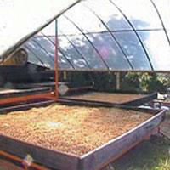
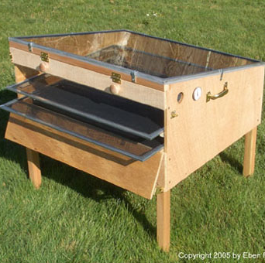
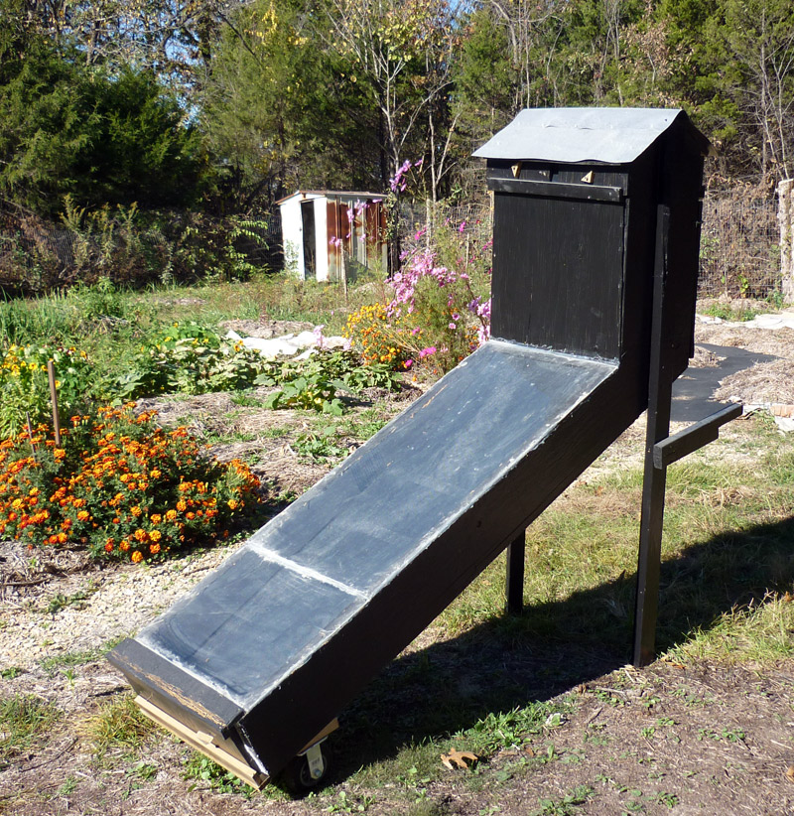
Solar dehydrator
Team one
STATE OF THE ART
COMPETITORS ANALYSIS
INDUSTRIAL DEHYDRATORS “25% DO IT YOURSELF” 100% DO IT YOURSELF
Shri Industry Sunworks TM Google

Slide 4
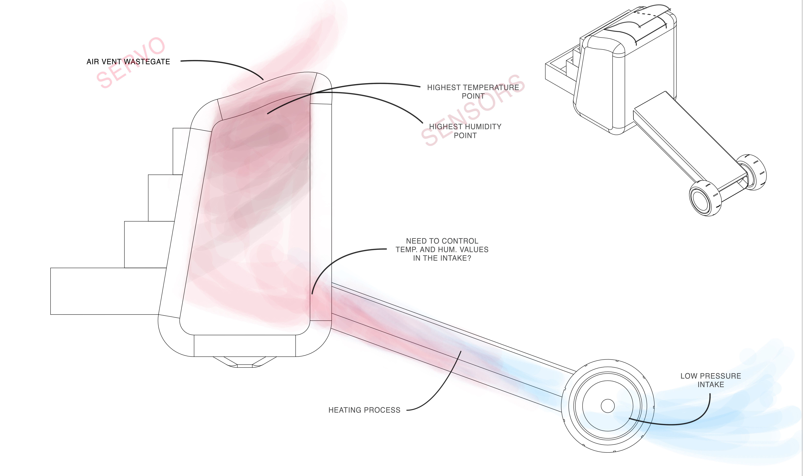
Solar dehydrator
Team one
STATE OF THE ART
FUNCTIONALITY AND REQUIREMENTS
WHAT & HOW
AIR PROCESS
HEATING
DEHYDRATING
REJECTING
CONTROL
TEMPERATURE
HUMIDITY
OUTTAKE
S.D. PARTS
TUNNEL
FOOD CHAMBER
AIR VENT
ELECTRONICS
ARDUINO &
SENSORS
SERVOMOTOR

Slide 5
Solar dehydrator
Team one
PROJECT MANAGEMENT
SCOPE
·NEW MARKET CLATEGORY·
QUALITY
COMFORT
SUSTAINABILITY
COST
GROUP METHOD
COMPARISON METHOD
DETAIL METHOD
-
DIRECT COSTS
INDIRECT COSTS
STAKEHOLDERS
DEFINE STAKEHOLDERS
FIND INTEREST
FIND POWER
MAPPING STAKEHOLDERS

Slide 6
Solar dehydrator
Team one
MARKETING PLAN
THE STRUCTURE
· MARKET ANALYSIS ·
MACRO ANALYSIS
MICRO ANALYSIS
· TARGET GROUP ·
SWOT ANALYSIS
STRATEGIC OBJECTIVES

Slide 7
Solar dehydrator
Team one
MARKETING PLAN
MARKET SEGMENTATION
ALL KIND OF DEHYDRATION
FOOD DEHYDRATION
NON-FOOD DEHYDRATION
MICROWAVES
OVEN / STOVE
DEHYDRATORS
REGULAR POWERED (MAIN MARKET)
SUSTAINABLE POWERED (MARKET NICHE)
HEATER SYSTEMS
DRYERS

Slide 8
Solar dehydrator
Team one
MARKETING PLAN
SUSTAINABILITY
Greengineers
Severin OD 2940
Bomann DR
435 CB
Stockli Dorrex
Sedona TM

Slide 9
Solar dehydrator
Team one
ETHICS & DEONTOLOGY
E&D
Engineering
Sales & Marketing
Academic
Liability
Environmental

Slide 10
Solar dehydrator
Team one
ENERGY & SUSTAINABILITY
ECONOMICAL
FAIR RATIO QUALITY-PRICE
LONG-LIFE
CONSUMERISM REDUCTION
SOCIAL
HEALTHY LIFESTYLE
KNOWLEDGE &
CONSCIOUSNES
WORK CONDITIONS
ENVIRONMENTAL
SELF-POWERED
RATIO LIFESPAN-IMPACT
OPTIMUM PRODUCTION TIMES

Slide 11
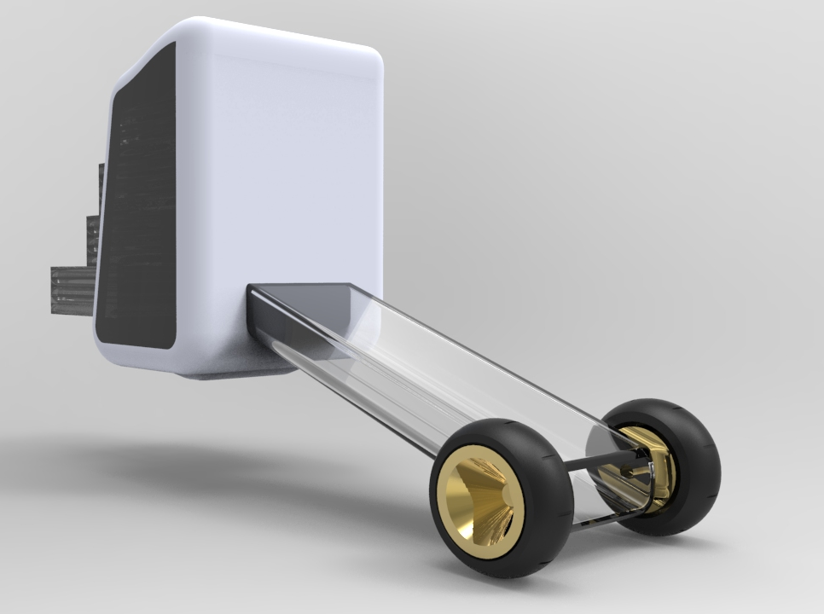
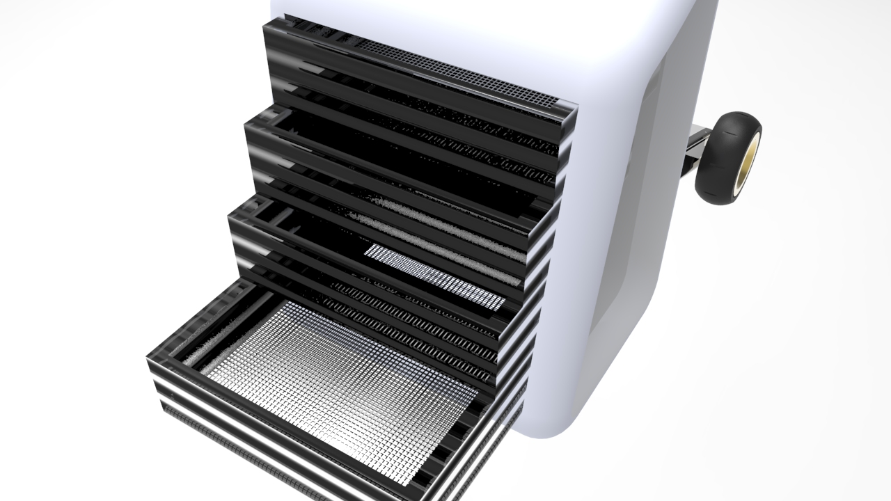
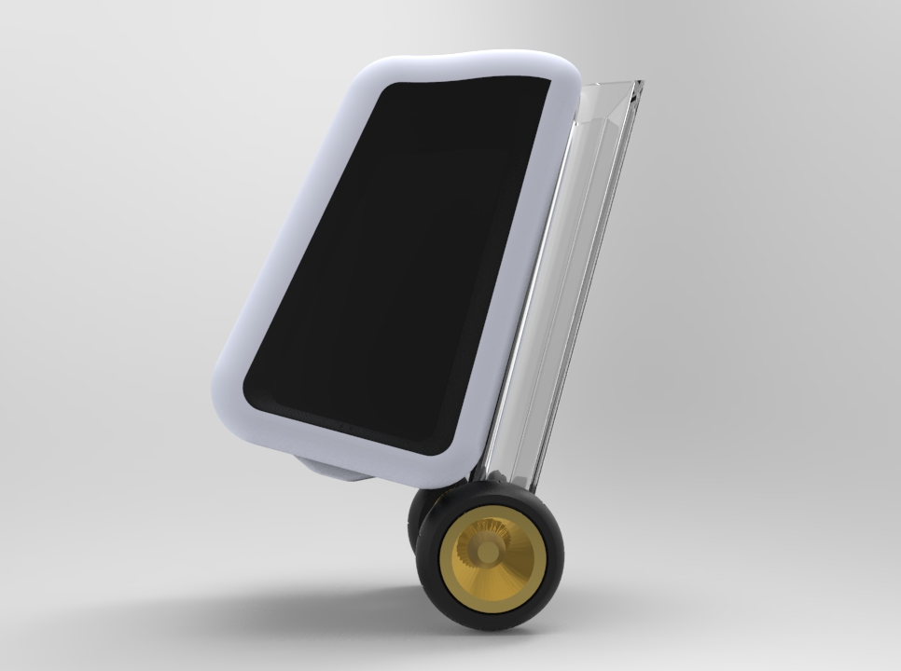
Solar dehydrator
Team one
PROPOSED SOLUTION
INITIAL CONCEPT
FOOD + SOLAR + PORTABLE + GARDEN + SMALL + ATTRACTIVE + CONTROL + SUSTAINABLE

Slide 12
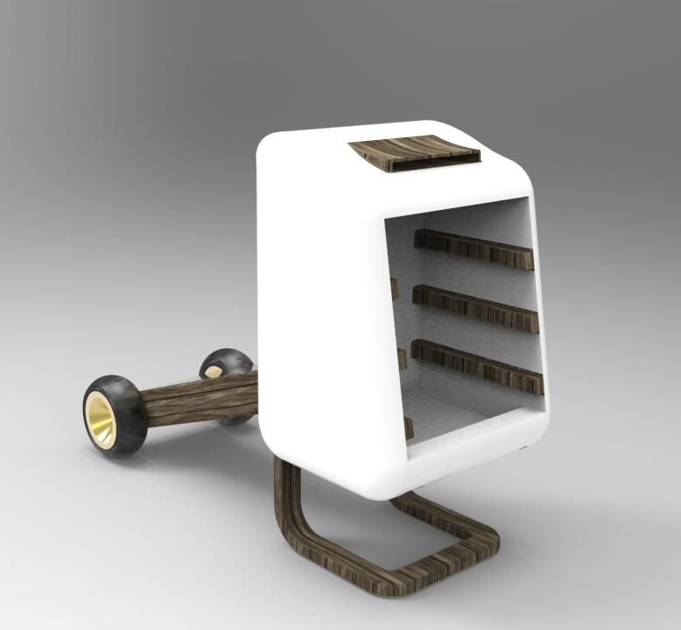

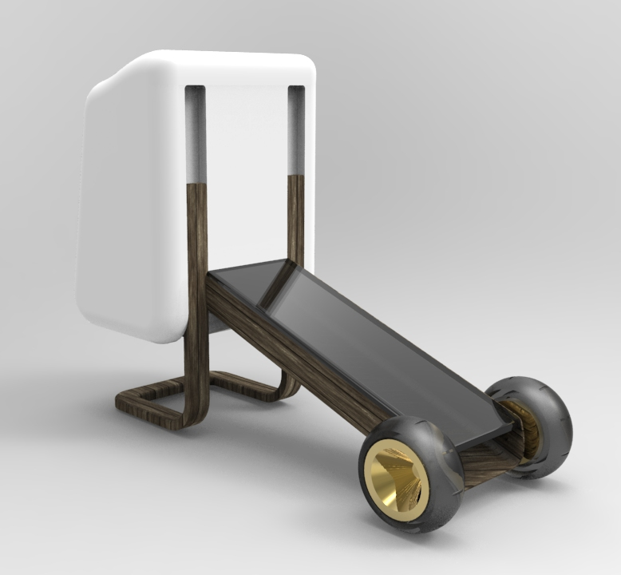
Solar dehydrator
Team one
PROPOSED SOLUTION
MECHANIC BASES
WOOD + PORTABLE + AIR VENT + MODULAR DESIGN + SHELVES DISTRIBUTION + WHEEL REQUIREMENTS

Slide 13
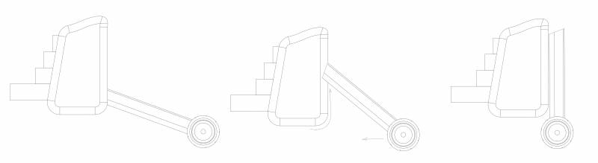
Solar dehydrator
Team one
PROPOSED SOLUTION
PORTABILITY DETAIL
MOVEMENT THROUGH A GUIDES SYSTEM

Slide 14
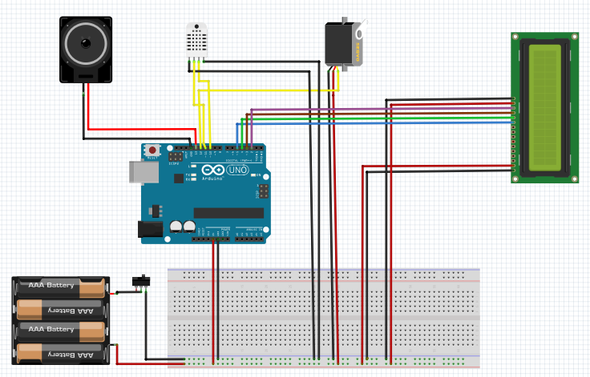
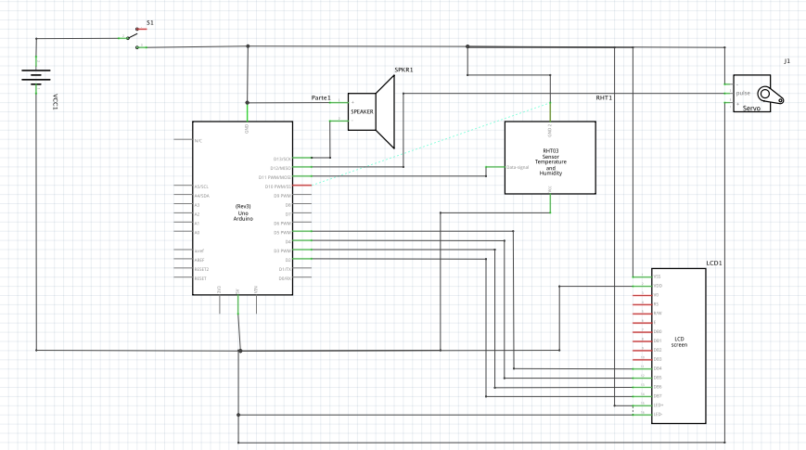
Solar dehydrator
Team one
PROPOSED SOLUTION
ELECTRONIC BASES
ARDUINO + TEMP. SENSOR + HUMIDITY SENSOR + SERVOMOTOR + LCD+ KEYBOARD+ BUZZER+ BATTERY + SOLAR PANEL

Slide 15
Solar dehydrator
Team one
CONCLUSIONS
ACHIEVEMENTS & FUTURE WORK
· PROJECT BASES ·
· INFORMATION MEMORY ·
· CARDBOARD PROTOTYPING ·
· PROCESS TESTING ·
· DEEP ELECTRONICS STUDY ·
· MANUFACTURING & TESTING ·
· FINAL PROJECT TOUCHES ·

Slide 16
Solar dehydrator
Team one
THANK YOU FOR YOUR
ATTENTION

